Slide 1
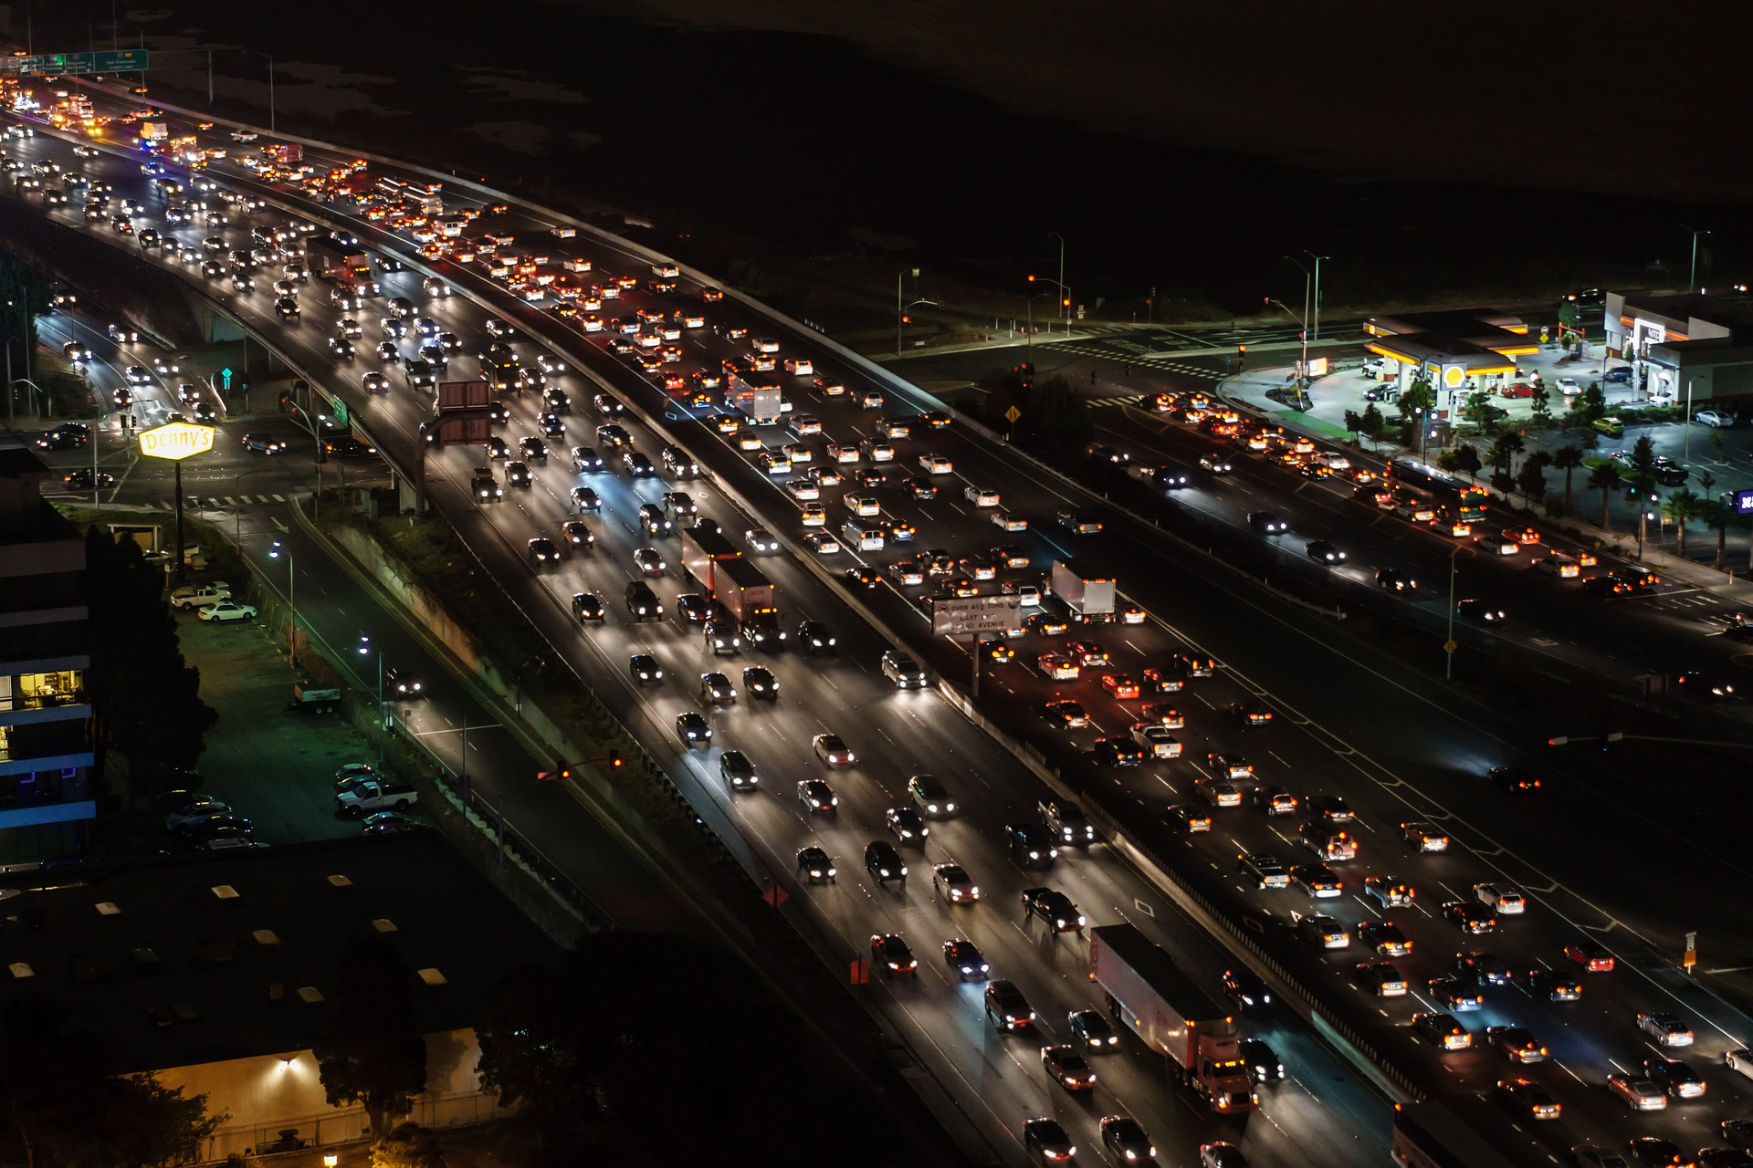
Bengaluru
TRAVEL OPTIMIZATION
Hertech Hackathon
By Madhavi Raman, HariShankar.G

Slide 2
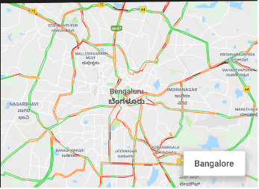
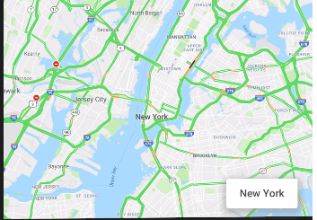
Introduction
Bangalore, One of the fatest growing cities also known as India’s Silicon Valley, and house of more than 2M workers and contributes to 10% to India’s GDP.
The expansion in Bangalore has been so great that it has grown twice its size in 40 years and 6000% increase in number of vehicles on the street.
Below is the live traffic from Newyork and Bangalore taken on a Saturday evening.
Following are the stats for people living per sq.km in
Newyork - 10,200 people/km²
Bangalore- 6,000 people/km²
However when observed, Bangalore’s traffic is very congested compared to New York.
According toThe New Indian Express A study has pegged the avoidable social cost of traffic congestion in Bengaluru at 38,000 crore Indian rupees annually

Slide 3
Introduction-Contd
As Bangalore traffic gets worse and infrastructure continues to fail, it seems like a fight. Many of them relocate to places near to workplace just to reduce the commute time.
While relocation is possible for some, for others it is not a feasible option and it leaves with an option to leave the workforce and majority are women who are getting affected by this.
In today’s hackathon challenge, we are proposing a solution
Recommendation Engine for Optimizing Office commute
Fastest route vs Safe route
Alternate Transport

Slide 4
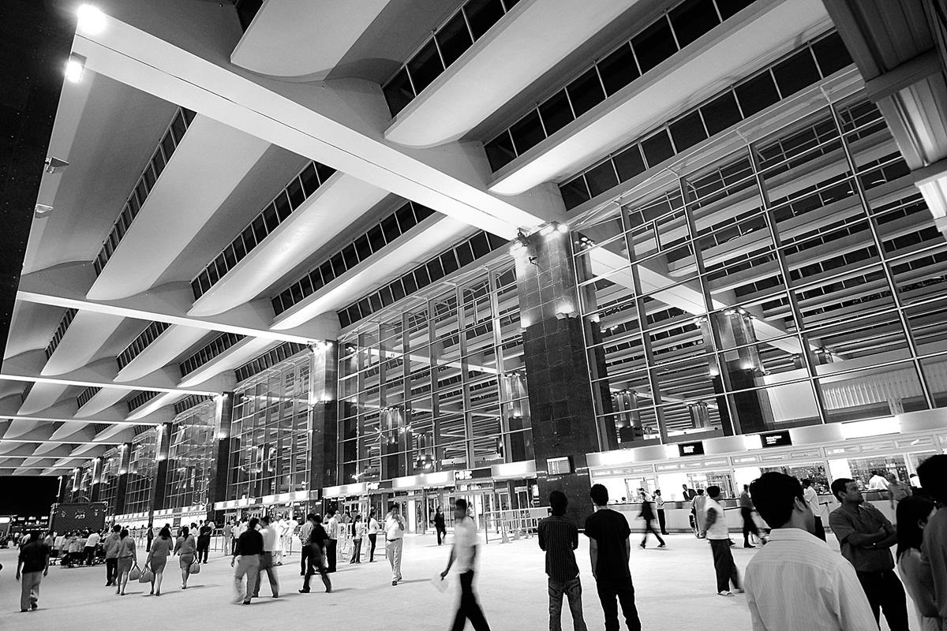
Use Case 1 Recommendation Engine for Optimizing Office Commute
1) Home & Office are stored in favorites
2) From historical data, we know the average time taken to go from Vijayanagar (110 origin id) & Whitefield (169 origin id) (Travel times , wards datasets)
3) We have data for 5 different time segments of a day (early morning, AM peak, midday, evening, PM peak) (Travel times daily dataset)
4) We have historical data for travel time for every day of the week (travel time day of the week dataset)
5) From all the above data, we will create a recommendation engine, which will give 3 recommendations for starting the journey. (Recommendation will be available from previous night, as a message, so the lady can plan her next day’s travel start time)
Notes:
Consider talking about:
Air
Namma Metro (Rail)
Road

Slide 5
Use Case 2 Fastest route Vs Safe Zone route 1
Notifying safe zones on the chosen path, & alternate path (costly path) with more safe zone coverage
e.g. Fastest route – 90 mins to cover 20 kms
Safest route – 105 minutes to cover 20 kms
Notes:
Consider talking about:
Air
Namma Metro (Rail)
Road

Slide 6
Use case 3 – Alternate Transport
Giving alternate routing solution with a mix of public and private transport including last mile connectivity
e.g. origin – auto 2 kms – metro 18 kms – rental cycle pod to office 2 kms.
Using this Solution mix, you reach destination in 100 minutes
Notes:
Consider talking about:
Air
Namma Metro (Rail)
Road

Slide 7
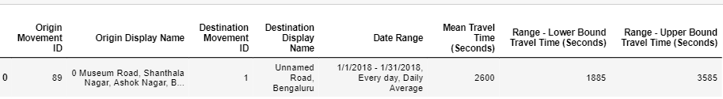
DataSET Used
We have exported data from Uber Movement. It is a open source status data of Banaglore traffic from 01/01/2018 to 31/01/2018.
bangalore-wards-2018-4-All-HourlyAggregate (1)
Travel_Times
Travel_Times_Daily
Travel_Times_day_of_week
Travel_Times_time_of_day
They are all csv files.
Sample Data

Slide 8
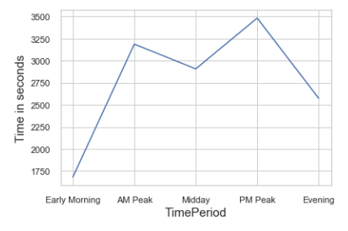
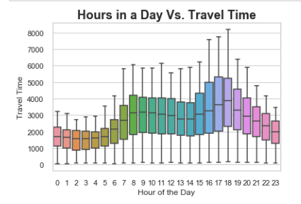
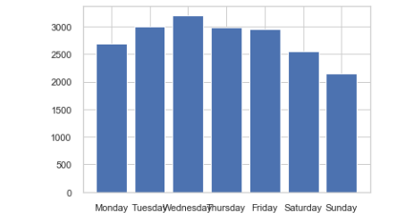
Exploratory Data Analysis
Source - 89- Museum Road
Destination - 169- Whitefield
Observation 1:The average Time taken for travel between source and destination is 46 mins at any given day.
Average time taken on any given day at different times is as below
Observation 2: The travel time peak at the morning say(8-11) and also during the evening(6-8). It is the time when people either rush from or to workplace.
Observation 3: It is traffic model between the source and destination on all days of the week.

Slide 9
Proof of concept using MS Azure

Slide 10
Revenue Model
Freemium model for individual users for 1 year(25k users)
Rs.10 Per month for recommendations per user(2.5k)
Push ads at the end of trips for freemium users. Rs.10 Per ad from B (20k trips*10rs*200 days = Rs.40Crores

Slide 11
Solution Roadmap
Identification of problem statement, business validation
Acquisition of datasets, data cleaning, EDA
Implementing Usecase1
Pilot roll out of Usecase 1, implementation of usecase 2
Integrated solution roll out to commercial customers all 3 usecases
00
01
02
03
04
05
06
07
08
09
10
11
12
Apr
May
June
Jul
Aug
Sep
Oct
Nov
Dec
Jan
Feb
Mar
Apr
Start
Q2
Q3
Q4
Q1

Slide 12
Thanks

